Slide 1
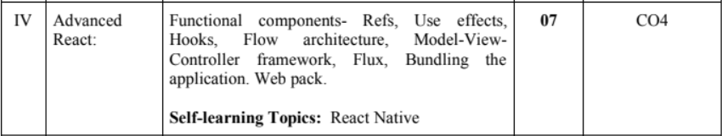

Slide 2
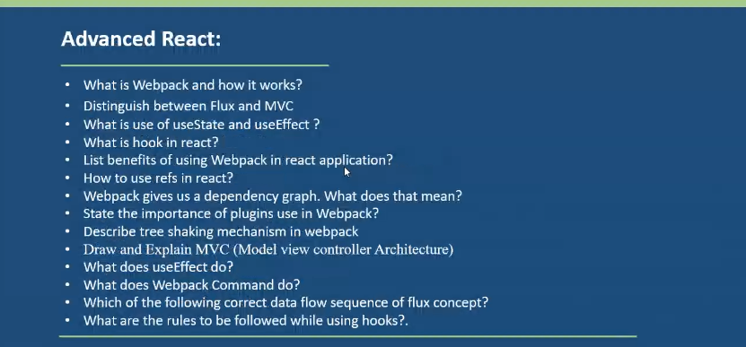

Slide 3
ReactJS Refs
Q. 1) What is React refs? When to Use Refs? When not to Use Refs?
Refs is the shorthand used for references in React. Refs are a feature that allow React components to interact with child elements. It provides a way to access React DOM nodes or React elements and how to interact with it.
Refs are a function provided by React to access the DOM element and the React element that you might have created on your own.
It is used when we want to change the value of a child component, without making the use of props. They also provide us with good functionality as we can use callbacks with them.
It is an attribute which makes it possible to store a reference to particular DOM nodes or React elements.

Slide 4
In the typical React dataflow, props are the only way that parent components interact with their children. However, there are a few cases where you need to imperatively modify a child outside of the typical dataflow. In such a cases to modify a child, you re-render it with new props.
The child to be modified could be an instance of a React component, or it could be a DOM element. For both of these cases, React provides an easy solution, refs.

Slide 5
When to Use Refs
Refs can be used in the following cases:
When we need DOM measurements such as Managing focus, text selection, or media playback.
It is used in Triggering imperative animations.
When Integrating with third-party DOM libraries.
It can also use as in callbacks.
When to not Use Refs
It’s use should be avoided for anything that can be done declaratively.
For example, instead of exposing open() and close() methods on a Dialog component, you need to pass an isOpen prop to it.
You should have to avoid overuse of the Refs.

Slide 6
Creating Refs - How to Create Refs?
In React, Refs can be created by using React.createRef(). It can be assigned to React elements via the ref attribute.
Refs are created using React.createRef() and attached to React elements via the ref attribute. When a component is constructed, Refs are assigned to an instance property and they are referenced throughout the component.

Slide 7
class MyComponent extends React.Component {
constructor(props) {
super(props);
this.callRef = React.createRef();
}
render() {
return <div ref={this.callRef} />;
}
}

Slide 8
How to access Refs
In React, when a ref is passed to an element inside render method, a reference to the node can be accessed via the current attribute of the ref.
const node = this.callRef.current;
The value of the ref differs depending on the type of the node:
When the ref attribute is used on an HTML element, the ref created in the constructor with React.createRef() receives the underlying DOM element as its current property.
When the ref attribute is used on a custom class component, the ref object receives the mounted instance of the component as its current property.
As Refs do not have instances so you can not use it’s attribute on function components..

Slide 9
Adding a Ref to a DOM Element
Q.2) How to add Ref to DOM element ?
This code uses a ref to store a reference to a DOM node:
import React, { Component } from 'react';
import { render } from 'react-dom';
class App extends React.Component {
constructor(props) {
super(props);
this.callRef = React.createRef();
this.addingRefInput = this.addingRefInput.bind(this);
}
addingRefInput() {
// Explicitly focus the input using the raw DOM API and we’re accessing “current” to get the DOM node
this.callRef.current.focus(); }
render() {
// Tell React that we want to associate the <input> ref
// With the ‘addRefInput’ that we created in the constructor
return ( <div> <h2>Adding Ref to DOM element</h2>
<input type="text" ref={this.callRef} />
<input type="button" value="Add text input" onClick={this.addingRefInput} />
</div> ); } }
export default App;
https://www.javatpoint.com/react-refs

Slide 10
For Online execution
https://stackblitz.com/edit/react-ts-r3gbkt?file=App.tsx
Open Online execution
https://replit.com/@AllanLopes1/DenseBasicEnterprise#src/App.jsx

Slide 11
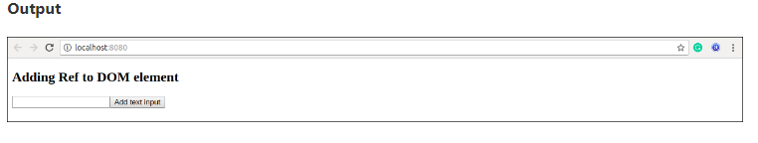

Slide 12
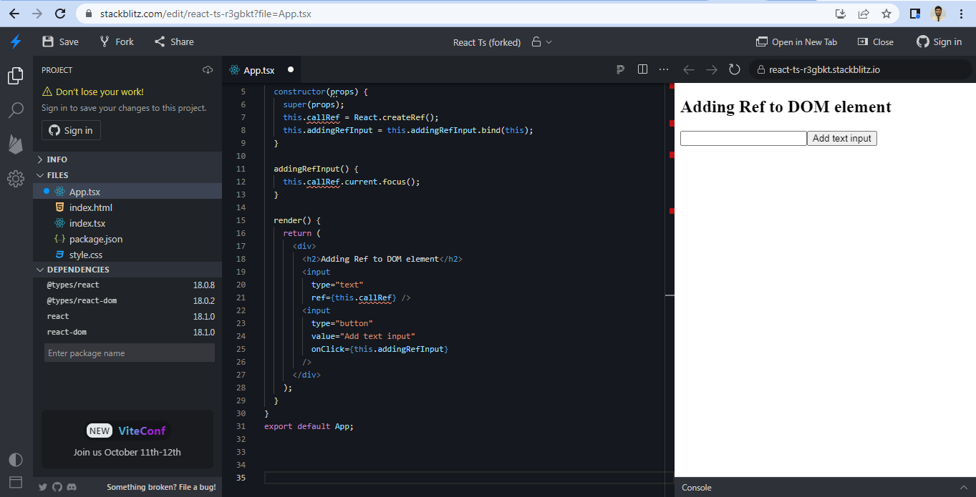

Slide 13
Add Ref to Class components Q.2) How to add Ref to Class components ?
In the below example, we are adding a ref to store the reference to a class component.
import React, { Component } from 'react';
import { render } from 'react-dom';
function CustomInput(props) {
let callRefInput = React.createRef();
function handleClick() {
callRefInput.current.focus(); }
return (
<div>
<h2>Adding Ref to Class Component</h2>
<input type="text" ref={callRefInput} />
<input type="button" value="Focus input" onClick={handleClick} />
</div> );
}
class App extends React.Component {
constructor(props) {
super(props);
this.callRefInput = React.createRef();
}
focusRefInput() {
this.callRefInput.current.focus();
}
render() {
return (
<CustomInput ref={this.callRefInput} />
);
}
}
export default App;
https://replit.com/@AllanLopes1/DenseBasicEnterprise#src/App.jsx

Slide 14
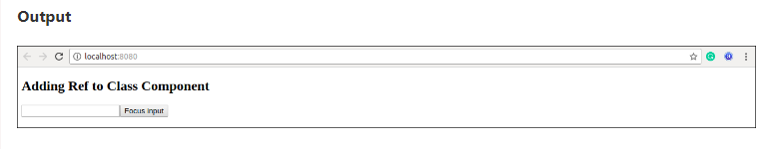

Slide 15
Callback Refs
React also supports another way to use/set refs called “callback refs”, which gives more fine-grain/more control over when refs are set and unset.
Instead of passing a ref attribute created by createRef(), React allows a way to create refs by passing a callback function to the ref attribute of a component.) to you pass a function. The function receives the React component instance or HTML DOM element as its argument, which can be stored and accessed elsewhere.
It looks like this <input type="text" ref= {this.setInputRef} /> or
<input type="text" ref= {element => this.callRefInput = element} />
The example below implements a common pattern: using the ref callback to store a reference to a DOM node in an instance property.

Slide 16
App.js
// Callback refs
import React, { Component } from 'react';
import { render } from 'react-dom';
class App extends React.Component {
constructor(props) {
super(props);
this.textInput = null;
this.setTextInputRef = element => {
this.textInput = element;
};
this.focusTextInput = () => {
// Focus the text input using the raw DOM API
if (this.textInput) this.textInput.focus();
};
}
componentDidMount() {
// autofocus the input on mount
this.focusTextInput();
}
render() {
// Use the `ref` callback to store a reference to the text input DOM
// element in an instance field (for example, this.textInput).
return (
<div>
<input type="text" ref={this.setTextInputRef} />
<input type="button" value="Focus the text input" onClick={this.focusTextInput} />
</div>
);
}
}
export default App;

Slide 17
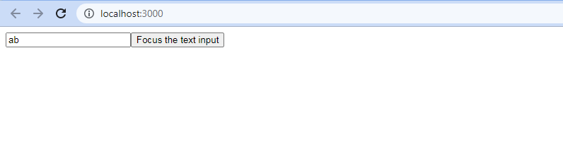
In above example, React will call the “ref” callback to store the reference to the input DOM element when the component mounts, and when the component unmounts, call it with null.
Refs are always up-to-date before the componentDidMount or componentDidUpdate fires.
The callback refs pass between components is the same as you work with object refs, which is created with React.createRef().

Slide 18
Advanced React -Functional Components- Refs Online material
https://reactjs.org/docs/higher-order-components.html
https://www.geeksforgeeks.org/reactjs-functional-components/
https://reactjs.org/docs/refs-and-the-dom.html
https://drive.google.com/file/d/1D-8a9ekoLoVOaifU68ye9cgG43W5WNJK/view

Slide 20


Slide 21
React.js is an open-source JavaScript-based user interface library. It is hugely popular for web and mobile app development.
React follows the principle of component-based architecture. A component in React is an isolated and reusable piece of code. The components can be of two types – class components and functional components.
Before React version 16.8, developers could handle state and other React features only using class components. But with version 16.8, React introduced a new pattern called Hooks.
With React Hooks, we can use state, and other React features, in a functional component. It empowers devs(DEVelopment) to do functional programming in React.

Slide 22
Before You Learn About Hooks...
Before you think of hooks, think of plain-old JavaScript functions.
In the JavaScript programming language, functions are reusable code logic to perform repeated tasks. Functions are composable. This means you can invoke a function in another function and use its output.

Slide 23
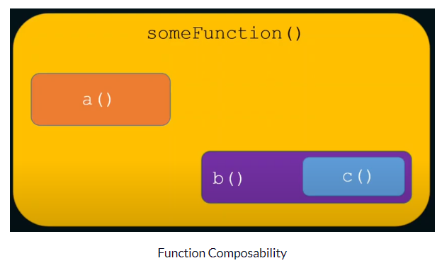
In the image below, the someFunction() function composes (uses) functions a() and b(). The b() function uses the function c().

Slide 24
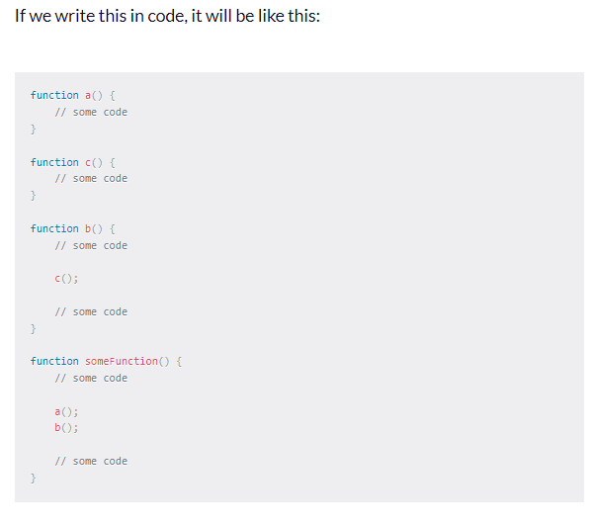
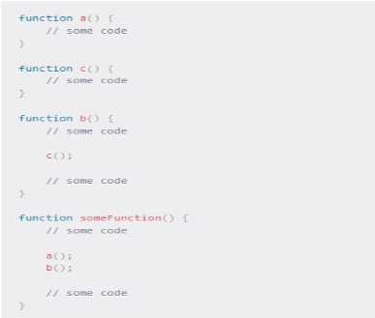

Slide 25
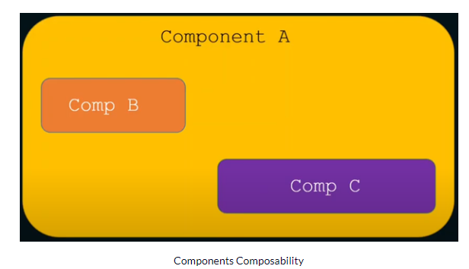
It is not a secret that functional components in React are just plain old JavaScript functions! So if functions have composability, React components can also have composability. This means we can use (compose) one or more components into another component as shown in the image below:

Slide 26
Stateful vs. Stateless Components
Components in React can be stateful or stateless.
A stateful component declares and manages local state in it.-( A components which manages the state and having some kind of state or tracks and there are certain things happens that changes the state.
Ex. A count variable initialized with one( count=1) there is button you clicked on that every time you clicked on that count variable increases the value. So it has state called count and it has side effect that it is changing the state the side effect is clicking on the button which is changing the state that incrementing the count by +1 every time you clicked on it. So a component like that is a stateful component because it manages the state.
In React the component should be like a pure function, A pure function is a function without any side-effects. This means that a function always returns the same output for the same input. (if you pass a similar argument to a pure function it will always result it to similar output, side effect change a phenomena that a function being a pure function so there might be something inside the function that will force that function not to return same output every time for the same input, that is side effect.

Slide 27
In React each of the component should be as much as possible should be stateless i.e each of the function should be as much as possible should be like a pure function. It should not have much of the side effects. But if we are building a real application side effects are must, you want to make a network call ( Ex. window.fetch() ) and change something, you want to click on button and change something. So w/o side effect we won’t be able to build anything, which is good and usable. But at the same time we have to go by paradigm of stateless component.
A stateless component is a pure function that doesn't have a local state and side-effects to manage.If we take out the stateful and side-effects logic from a functional component, we have a stateless component. Also, the stateful and side-effects logic can be reusable elsewhere in the app. So it makes sense to isolate them from a component as much as possible.

Slide 28
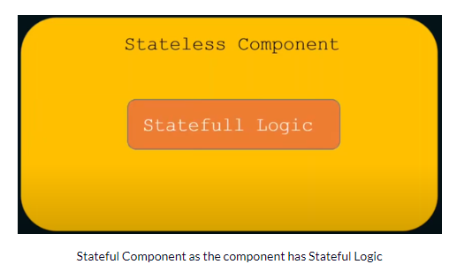
So Here all the statefulness we can park into some other components or some other functions, so stateful logic goes into another function, another component. That particular thing is called HOOK.

Slide 29
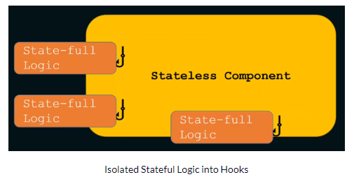
React Hooks and Stateful Logic
With React Hooks, we can isolate stateful logic and side-effects from a functional component. Hooks are JavaScript functions that manage the state's behaviour and side effects by isolating them from a component. So, we can now isolate all the stateful logic in hooks and use (compose them, as hooks are functions, too) into the components.

Slide 30
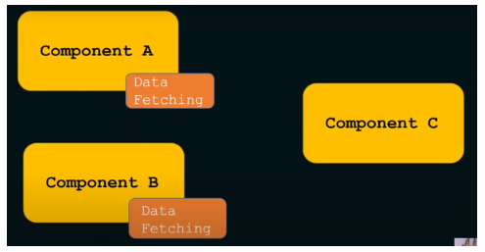
what is this stateful logic? It can be anything that needs to declare and manage a state variable locally. For example, the logic to fetch data and manage the data in a local variable is stateful. We may also want to reuse the fetching logic in multiple components.

Slide 31
React Hooks are simple JavaScript functions that we can use to isolate the reusable part from a functional component. Hooks can be stateful and can manage side-effects.
It is just another JavaScript function to deal with state and side-effects outside of functional components.
Hook has certain access to React capabilities, for ex. State- managing the state, managing the side effects which pure function does not have access capabilities straight away.

Slide 32
What are Pure Functions and Side Effects in JavaScript?
https://www.youtube.com/watch?v=vxfVNXJyeHk

Slide 33
React Hooks- Must read :- https://www.freecodecamp.org/news/react-hooks-fundamentals/ https://www.youtube.com/watch?v=CvNvRaS3u60
React Hooks are simple JavaScript functions that we can use to isolate the reusable part from a functional component. Hooks can be stateful and can manage side-effects. React provides a bunch of standard in-built hooks: useState : To manage states.
Hooks are a new addition in React 16.8. It allows you to use state and other React features without writing a class.
Hooks are the functions which "hook into" React state and lifecycle features from function components. It does not work inside classes.
Hooks are backward-compatible, which means it does not contain any breaking changes. Backward compatible (also known as downward compatible or backward compatibility) refers to a hardware or software system that can successfully use interfaces and data from earlier versions of the system or with other systems.

Slide 34
When to use a Hooks
Before Hooks introduction, when you write a function component, and then you want to add some state to it, previously you do this by converting it to a class. But, now you can do it by using a Hook inside the existing function component.

Slide 35
Motivation to use Hooks
It’s hard to reuse strategic logic between components
React doesn’t offer a way to “attach” reusable behavior to a component (for example, connecting it to a store). Hooks allow you to reuse stateful logic without changing your component hierarchy. Using Hooks, you can extract stateful logic from a component so it can be tested independently and reuse.
Complex components become hard to understand
In many cases it’s not possible to break these components into smaller ones because the stateful logic is all over the place. It’s also difficult to test them. This is one of the reasons many people prefer to combine React with a separate state management library. However, that often introduces too much abstraction, which requires you to jump between different files, and makes reusing components more difficult. To solve this, Hooks let you split one component into smaller functions based on what pieces are related.

Slide 36
Classes confuse both people and machines
We found that class components can encourage unintentional patterns that make these optimizations fall back to a slower path.
Classes don’t minify very well, and they make hot reloading flaky and unreliable.
Hooks let you use more of React’s features without classes.

Slide 37
Rules of Hooks
Hooks are similar to JavaScript functions, but you need to follow these two rules when using them. Hooks rule ensures that all the stateful logic in a component is visible in its source code. These rules are:
1. Only call Hooks at the top level
Hooks should always be used at the top level of the React functions. Do not call Hooks inside loops, conditions, or nested functions. This rule ensures that Hooks are called in the same order each time a components renders.
2. Only call Hooks from React functions
You cannot call Hooks from regular JavaScript functions. Instead, you can call Hooks from React function components. Hooks can also be called from custom Hooks.

Slide 38
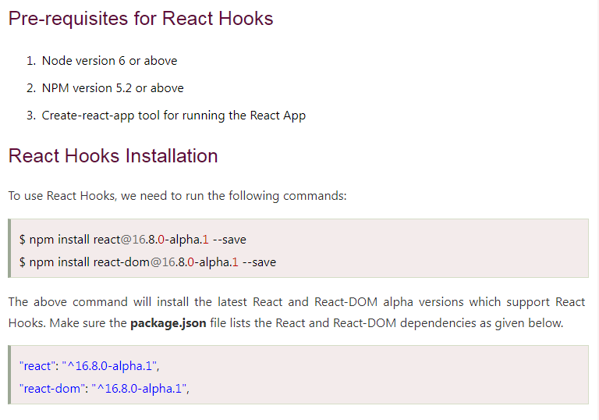

Slide 39
Hooks State
Hook state is the new way of declaring a state in React app. Hook uses useState() functional component for setting and retrieving state. Let us understand Hook state with the following example.

Slide 40
App.js
In the above example, useState is the Hook which needs to call inside a function component to add some local state to it.
The useState returns a pair where the first element is the current state value/initial value, and the second one is a function which allows us to update it.
After that, we will call this function from an event handler or somewhere else. The useState is similar to this.setState in class.
//Hooks State
import React, { useState } from 'react';
function App() {
// Declare a new state variable, which we'll call "count"
const [count, setCount] = useState(0);
return (
<div>
<p>You clicked {count} times</p>
<button onClick={() => setCount(count + 1)}> Click me
</button>
</div>
);
}
export default App;

Slide 41
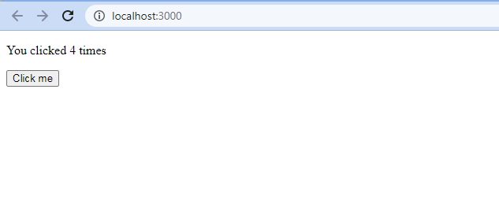

Slide 42
Hooks Effect
The Effect Hook allows us to perform side effects (an action) in the function components. It does not use components lifecycle methods which are available in class components. In other words, Effects Hooks are equivalent to componentDidMount(), componentDidUpdate(), and componentWillUnmount() lifecycle methods.
Side effects have common features which the most web applications need to perform, such as:
Updating the DOM,
Fetching and consuming data from a server API,
Setting up a subscription, etc. (Subscriptions are similar to queries in that they specify a set of fields to be delivered to the client, but instead of immediately returning a single answer, a result is sent every time a particular event happens on the server.)

Slide 43
App.js
//Hooks Effect
import React, { useState, useEffect } from 'react';
function App() {
const [count, setCount] = useState(0);
// Similar to componentDidMount and componentDidUpdate:
useEffect(() => {
// Update the document title using the browser API
document.title = `You clicked ${count} times`;
});
return (
<div>
<p>You clicked {count} times</p>
<button onClick={() => setCount(count + 1)}> Click me </button>
</div>
);
}
export default App;
The above code is based on the previous example with a new feature which we set the document title to a custom message, including the number of clicks.

Slide 44
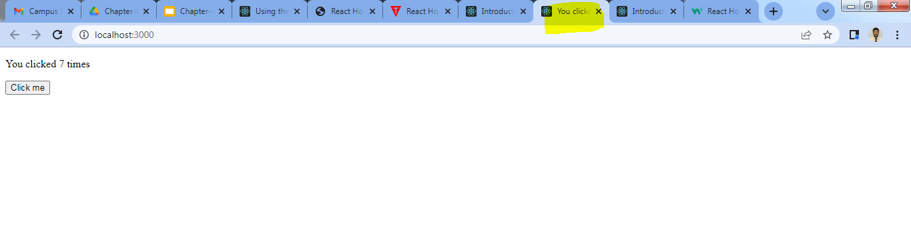

Slide 45
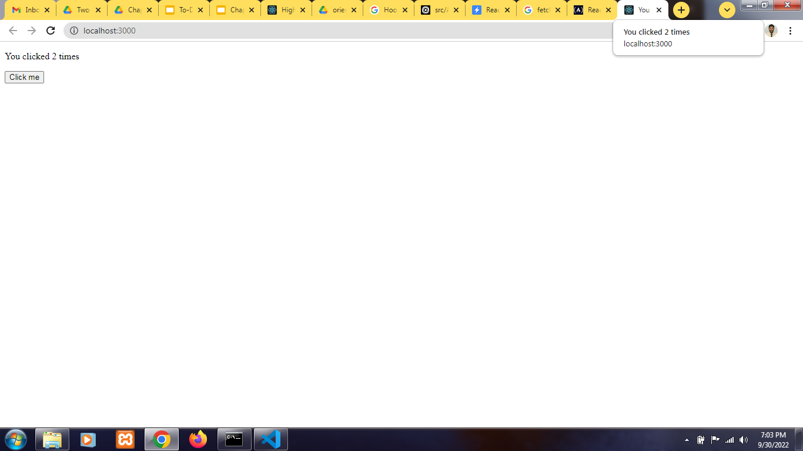

Slide 46
Q. Explain different types of side effects in react ?
Must Visit:-
https://www.w3schools.com/react/react_useeffect.asp
In React component, there are two types of side effects:
Effects Without Cleanup
Effects With Cleanup
Effects without Cleanup
It is used in useEffect which does not block the browser from updating the screen. It makes the app more responsive. The most common example of effects which don't require a cleanup are manual DOM mutations, Network requests, Logging, etc.
- Pure Functions & Side Effects:https://www.youtube.com/watch?v=vxfVNXJyeHk
Effects with Cleanup
Some effects require cleanup after DOM updation. For example, if we want to set up a subscription to some external data source, it is important to clean up memory so that we don't introduce a memory leak. React performs the cleanup of memory when the component unmounts. However, effects run for every render method and not just once. Therefore, React also cleans up effects from the previous render before running the effects next time.

Slide 47
Custom Hooks
A custom Hook is a JavaScript function. The name of custom Hook starts with "use" which can call other Hooks.
A custom Hook is just like a regular function, and the word "use" in the beginning tells that this function follows the rules of Hooks. Building custom Hooks allows you to extract component logic into reusable functions.
Let us understand how custom Hooks works in the following example.

Slide 48
App.js
//Custom Hooks
import React, { useState, useEffect } from 'react';
const useDocumentTitle = title => {
useEffect(() => {
document.title = title;
}, [title])
}
function App() {
const [count, setCount] = useState(0);
const incrementCount = () => setCount(count + 1);
useDocumentTitle(`You clicked ${count} times`);
// useEffect(() => {
// document.title = `You raj have clicked ${count} times`
// });
return (
<div>
<p>You clicked {count} times</p>
<button onClick={incrementCount}>Click me</button>
</div>
)
}
export default App;
In the above snippet, useDocumentTitle is a custom Hook which takes an argument as a string of text which is a title.
Inside this Hook, we call useEffect Hook and set the title as long as the title has changed. The second argument will perform that check and update the title only when its local state is different than what we are passing in.

Slide 49
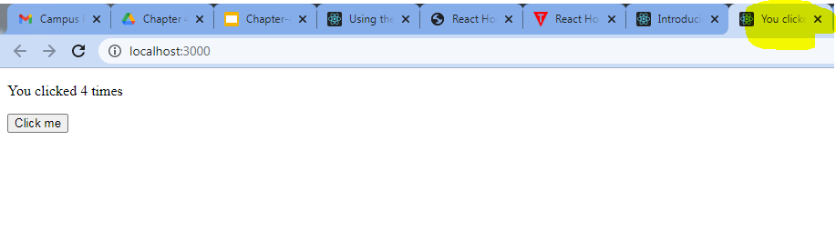

Slide 50
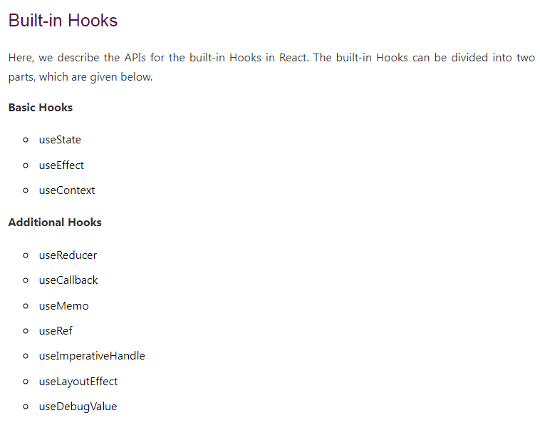
Must Visit
https://www.w3schools.com/react/react_hooks.asp
https://www.freecodecamp.org/news/react-hooks-fundamentals/

Slide 51
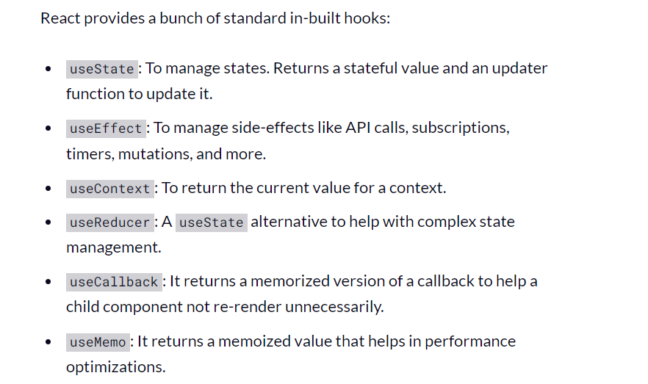

Slide 52
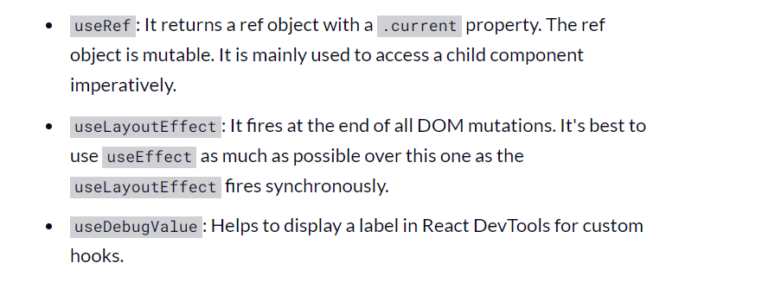
Please notice that each of these hook names start with use. Yes, this is a standard practice to identify a hook in the React codebase quickly.

Slide 53
Advanced React Hook
Useeffects
Usestate
Refs
https://reactjs.org/docs/hooks-intro.html
https://www.javatpoint.com/react-hooks
https://www.valentinog.com/blog/hooks/
https://reactjs.org/docs/hooks-effect.html
https://reactjs.org/docs/refs-and-the-dom.html

Slide 55
MVC
MVC stands for Model View Controller. It is an architectural pattern used for developing the user interface. It divides the application into three different logical components: the Model, the View, and the Controller. Each of these components are built to handle specific development aspects of an application.
MVC is a popular way to organize the code. In our app we write different sections of code with different purposes, such as some part of the code holds the data of our app, some part of code makes our app look nice, and some of the code controls how app functions. The MVC help us to organize these parts of codes that is section as per purposes.
MVC organizes the code’s core functions into sections(boxes). This makes much easier for revisiting app’s code, and also for sharing with others app.
MVC is one of the most frequently used industry- standard web development framework to create scalable and extensible projects.
It is first introduced in 1976 in the Smalltalk programming language. In MVC, each component is built to handle specific development aspect of an application. It is one of the most used web development frameworks to create scalable projects.

Slide 56
MVC Architecture
The MVC architecture contains the three components. These are:
Model: The model contains only the pure application data, it contains no logic describing how to present the data to a user. It is responsible for maintaining the behavior and data of an application. The Model component corresponds to all the data-related logic that the user works with. This can represent either the data that is being transferred between the View and Controller components or any other business logic-related data. For example, a Customer object will retrieve the customer information from the database, manipulate it and update it data back to the database or use it to render data.

Slide 57
View: It is used to display the model in the user interface.
The View component is used for all the UI logic of the application. For example, the Customer view will include all the UI components such as text boxes, dropdowns, etc. that the final user interacts with.
Controller: It acts as an interface between the Model and the View components. It takes user input, manipulates the data(model) and causes the view to update. Controllers act as an interface between Model and View components to process all the business logic and incoming requests, manipulate data using the Model component and interact with the Views to render the final output.
For example, the Customer controller will handle all the interactions and inputs from the Customer View and update the database using the Customer Model. The same controller will be used to view the Customer data.

Slide 58
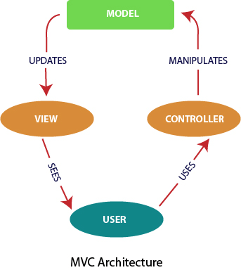
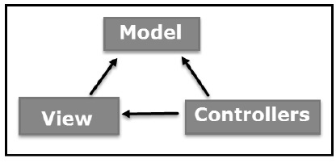

Slide 59
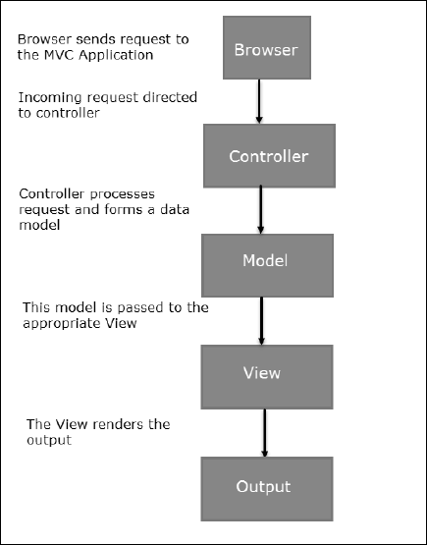

Slide 60
Advantages of MVC
Multiple developers can work simultaneously on the model, controller and views.
MVC enables logical grouping of related actions on a controller together. The views for a specific model are also grouped together.
Models can have multiple views.

Slide 61
Disadvantages of MVC
The framework navigation can be complex because it introduces new layer of abstraction and requires users to adapt to the decomposition criteria of MVC
Knowledge on multiple technologies becomes the norm. Developers using MVC need to be skilled in multiple technologies.
Note:- BUT MVC is an Object-oriented programming (OOP) pattern and React isn’t an Object-oriented library, it’s a functional programming (FP) library. React has been described as the “V” in MVC. For this “V” React has introduced Flux architecture.

Slide 62
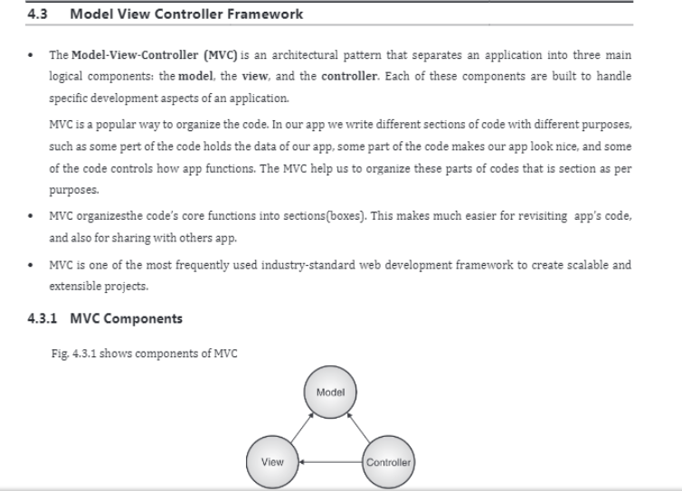
MVC

Slide 63
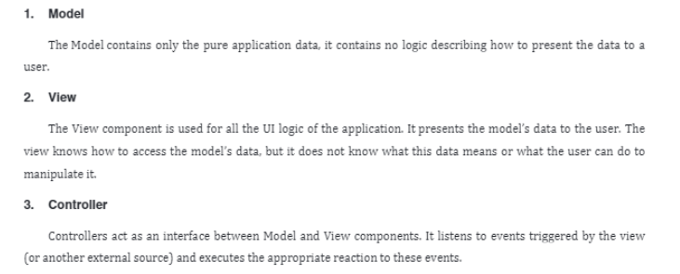

Slide 64
Application Data means a set of instructions which causes a computer system to perform a function when executed on the computer;

Slide 66
React Flux -
Explain React Flux or Explain architecture of Flux in detail.
Flux is an application architecture that Facebook uses internally for building the client-side web application with React. It is not a library nor a framework.
It is neither a library nor a framework. It is a kind of architecture that complements React as view and follows the concept of Unidirectional Data Flow model.
It is useful when the project has dynamic data, and we need to keep the data updated in an effective manner. It reduces the runtime errors.

Slide 67
When we are talking about flux we need to imaging about facebook, where we are interacting with fb, storing all the images etc.and now many things are coming up in different manner like you can have your photo in this manner, or show your photo with frames all this is because of Flux.

Slide 68
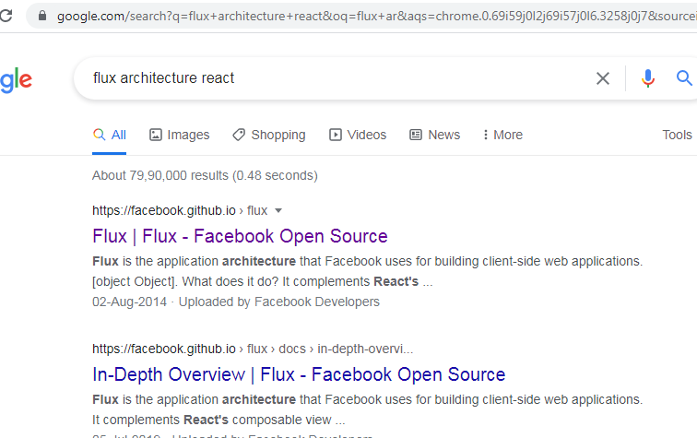

Slide 69
https://facebook.github.io/flux/docs/overview
https://facebook.github.io/flux/docs/in-depth-overview
In-Depth Overview of Flux and it’s component.

Slide 70
Flux applications have three major roles in dealing with data:
Dispatcher
Stores
Views (React components)
Here, you should not be confused with the Model-View-Controller (MVC) model. Although, Controllers exists in both, but Flux controller-views (views) found at the top of the hierarchy.
It retrieves data from the stores and then passes this data down to their children. Additionally, action creators - dispatcher helper methods used to describe all changes that are possible in the application. It can be useful as a fourth part of the Flux update cycle.
It is an alternative to MVC architecture and other software design patterns for managing how data flows in the react application. It is the backbone of all React application. It is not a library nor a framework. It complements React as view and follows the concept of Unidirectional Data Flow model.

Slide 71
The major idea behind Flux is that there is a single-source of truth( the stores) and they can only be updated by triggering actions.
The actions are responsible for calling the dispatcher, which the stores can subscribe for changes and update their own data accordingly.

Slide 72
https://www.javatpoint.com/react-flux-concept#:~:text=Flux%20is%20an%20application%20architecture,of%20Unidirectional%20Data%20Flow%20model.
In Flux application, data flows in a single direction(unidirectional). This data flow is central to the flux pattern. The dispatcher, stores, and views are independent nodes with inputs and outputs. The actions are simple objects that contain new data and type property. Now, let us look at the various components of flux architecture one by one.

Slide 73
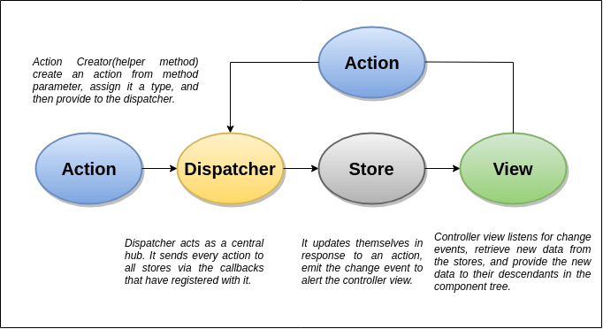

Slide 74
Dispatcher
It is a central hub for the React Flux application and manages all data flow of your Flux application. It is a registry of callbacks into the stores. It has no real intelligence of its own, and simply acts as a mechanism for distributing the actions to the stores. All stores register itself and provide a callback. It is a place which handled all events that modify the store. When an action creator provides a new action to the dispatcher, all stores receive that action via the callbacks in the registry.
The dispatcher's API has five methods. These are:

Slide 75
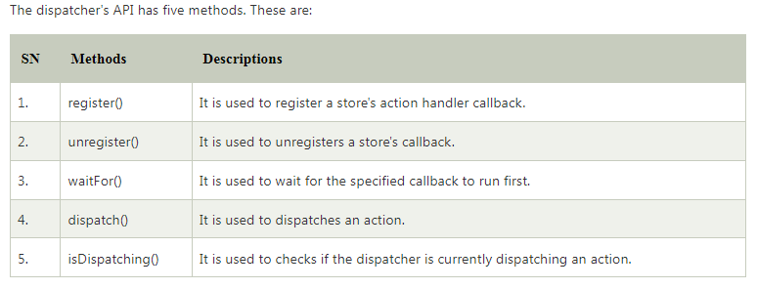

Slide 76
Stores
It primarily contains the application state and logic. It is similar to the model in a traditional MVC. It is used for maintaining a particular state within the application, updates themselves in response to an action, and emit the change event to alert the controller view.
Views
It is also called as controller-views. It is located at the top of the chain to store the logic to generate actions and receive new data from the store. It is a React component listen to change events and receives the data from the stores and re-render the application.

Slide 77
Actions
The dispatcher method allows us to trigger a dispatch to the store and include a payload of data, which we call an action. It is an action creator or helper methods that pass the data to the dispatcher.
Advantage of Flux
It is a unidirectional data flow model which is easy to understand.
It is open source and more of a design pattern than a formal framework like MVC architecture.
The flux application is easier to maintain.
The flux application parts are decoupled.
Flux example :-
ReactJS - Using Flux" https://www.tutorialspoint.com/reactjs/reactjs_using_flux.htm

Slide 78
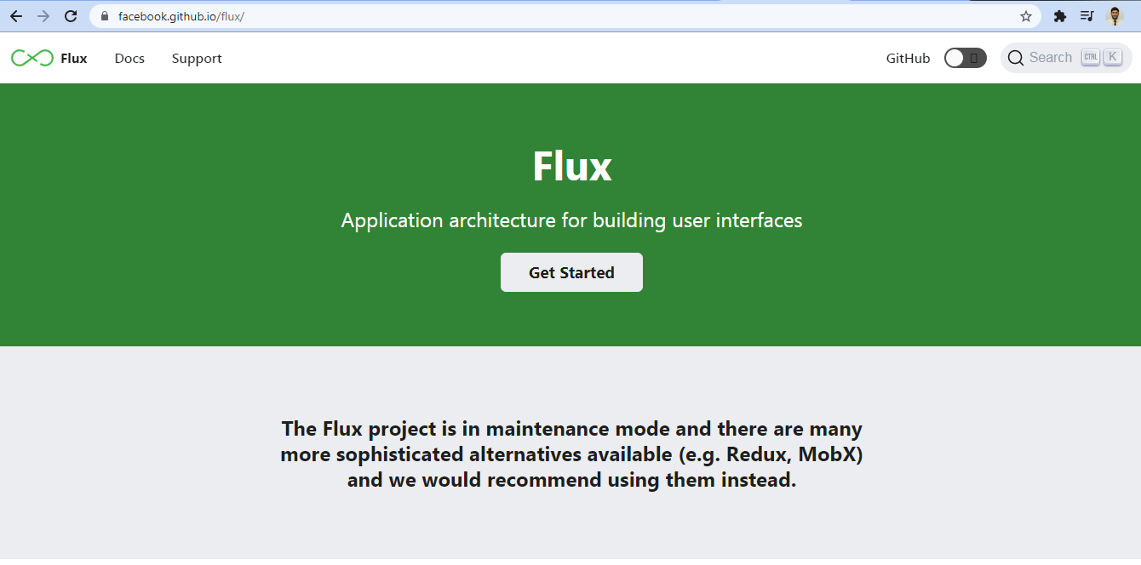
https://drive.google.com/file/d/1An6rrMPF26IXT-jXD5U1IBLu7OhVGciO/view?usp=sharing

Slide 79
An advanced react is nothing but Redux,
In react.js only certain component is getting rendered but flux is opposite, It is not a library nor a framework. It is a kind of architecture (An application architecture describes the patterns and techniques used to design and build an application. Software design patterns can help you to build an application. A pattern describes a repeatable solution to a problem. Patterns can be linked together to create more generic application architectures) that complements React as view and follows the concept of Unidirectional Data Flow model.
Flux is a Javascript architecture or pattern for UI which runs on a unidirectional data flow and has a centralized dispatcher. It is useful when your project has dynamic data and you need to keep the data updated in an effective manner. It was created by Facebook, and complements React as view.

Slide 80
User interface (UI) design refers to the aesthetic elements by which people interact with a product, such as buttons, icons, menu bars, typography, colors, and more. User experience (UX) design refers to the experience a user has when interacting with a product.
Ex:- UI is created in layers of interaction that appeal to the human senses (sight, touch, auditory and more). They include both input devices like keyboard, mouse, trackpad, microphone, touch screen, fingerprint scanner, e-pen and camera and output devices like monitors, speakers and printers
User experience (UX) design refers to the experience a user has when interacting with a product. It focuses on the user journey and how efficient and easy to use the product is. User experience" encompasses all aspects of the end-user's interaction with the company, its services, and its products.
Ex:- It is the personal, internal experience customers go through when using a product's interface. Let's take as an example an e-commerce website. ... This will probably push the customer to choose and purchase the products on those websites where she experienced a good user experience.
UX (user experience) and UI (user interface) are two interdependent terms. While UI generally deals with the interaction between users and computer systems, software and applications, UX deals more generally with a user's overall experience with a brand, product or service.
In React, a reusable component is a piece of UI that can be used in various parts of an application to build more than one UI instance. For instance, we can have a button component display with different colors in several parts of our application

Slide 81
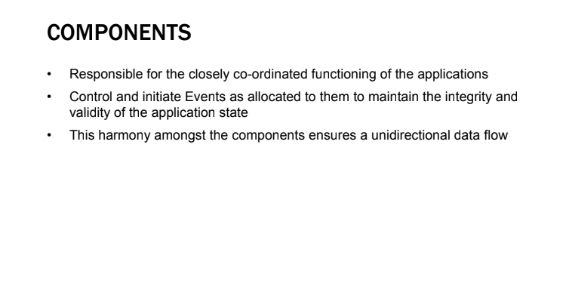

Slide 82
React native is cross platform (The cross-platform or multiplatform software is a type of application / program / software that works on various operating systems or devices, which are often called platforms. A platform means an operating system such as Windows, Mac OS, Android, or iOS.) dependent language which is used for mobile app development,
Dart programming lang. Which came up in 2017 built by google, Flutter is framework. Dart is inspired by javascript, c, c++, c#, java all the languages. Background we are using Dart and frontend we are using flutter, The flutter framework is used to design UI for mobile app, it is work with flux. So not only Facebook, but it works with react-native.

Slide 83
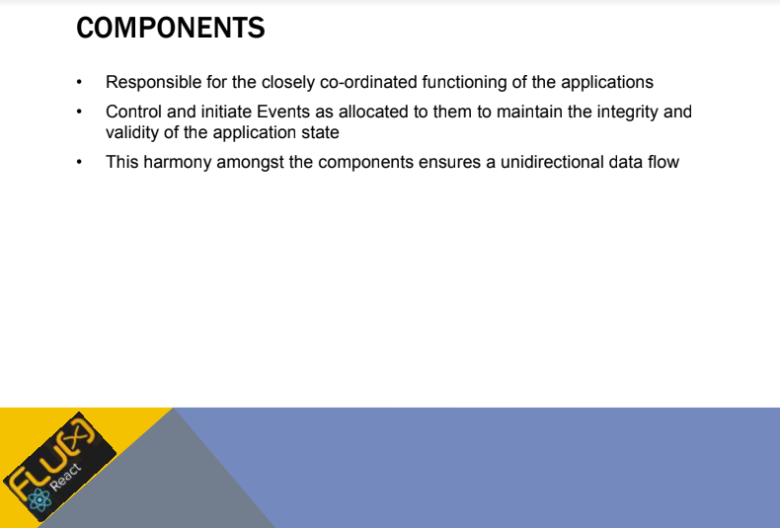
If you look at the events, you can control on the events, initiates the events, you can maintain not only the integrity but also validate the application states.
We can pass the parameter from one component to another using functions.
How can we call the value? using functions

Slide 84
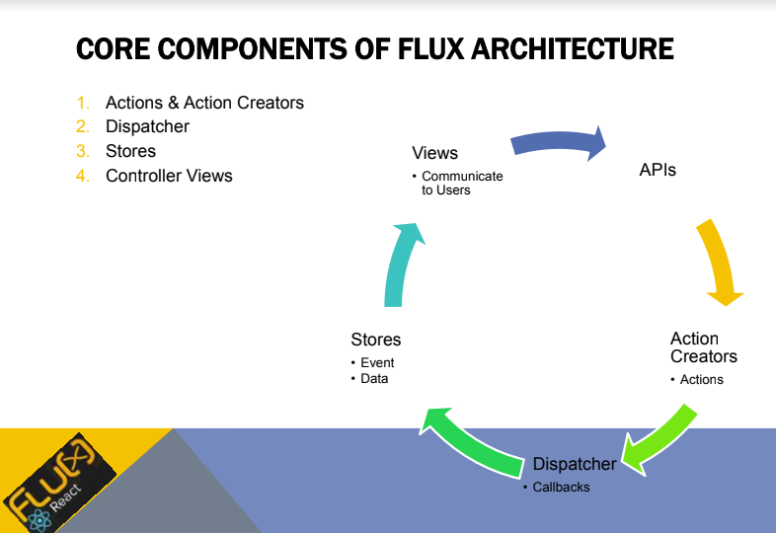

Slide 85
Callback function is nothing but Dispatcher, we have to define dispatcher in flux, we have to define the stores i.e data persistent data,(Persistent data in the field of data processing denotes information that is infrequently accessed and not likely to be modified. Static data is information, for example a record, that does not change and may be intended to be permanent. It may have previously been categorized as persistent or dynamic)
consistent data (Data that belongs together with regard to content and describes a process state at a specific time is called consistent data. For data to be consistent, it must not be changed or updated during processing or transfer. Example: You want to determine the mean value of a series of numbers.), discrete data(Discrete data is information that can only take certain values. This type of data is often represented using tally charts, bar charts or pie charts. Continuous data is data that can take any value. Height, weight, temperature and length are all examples of continuous data.) so we are going to store this data and events about how we are going to handle data.

Slide 86
Views:- How we are going to communicate with users?
User interaction is nothing but views.
Action Creators this are nothing but actions.

Slide 87
If I want to become flux, UI programmer using flux architecture then I should able to know 4 things:
How can I define Action Creator?
How can I define Dispatcher?
How can I define stores?
How can I define views?
If I can able to do this then I can able to do flux programming, kindly refer below link to know more,
https://facebook.github.io/flux/docs/in-depth-overview#a-single-dispatcher

Slide 88
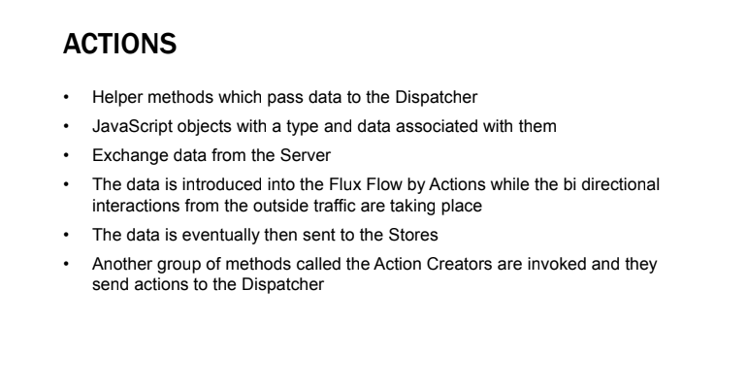

Slide 89
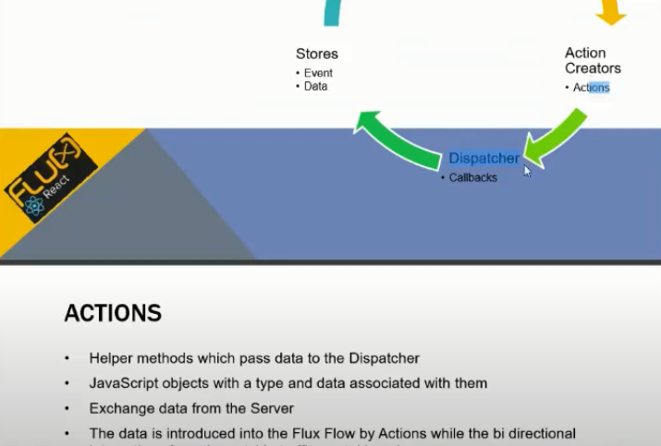

Slide 90
In javascript function itself creates an object, and we can pass the object to the another function, because we can pass one function to another function.

Slide 91
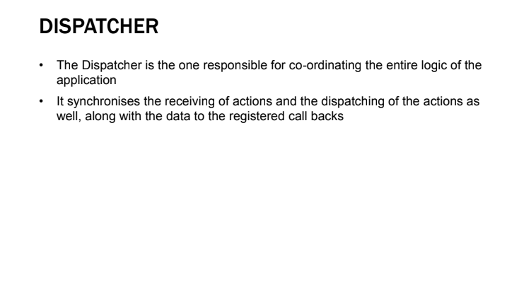

Slide 92
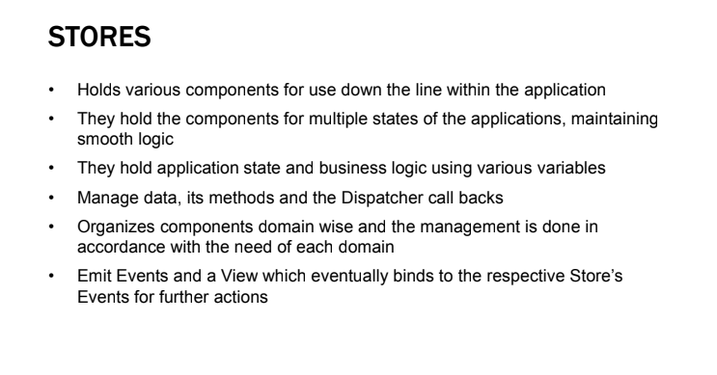
Application State (also known as Program State) represents the totality of everything necessary to keep your application running. When we refer to application state we are normally referring to the state of the program as it exists in the contents of its memory.

Slide 93
What does it mean to emit an event?
Event emitter is an object/method which triggers an event as soon as some action takes place so as to pass the control to the parent function. For-example- Server is an event emitter in Node. Js programming
Node. js allows us to create and handle custom events easily by using events module. Event module includes EventEmitter class which can be used to raise and handle custom events

Slide 94
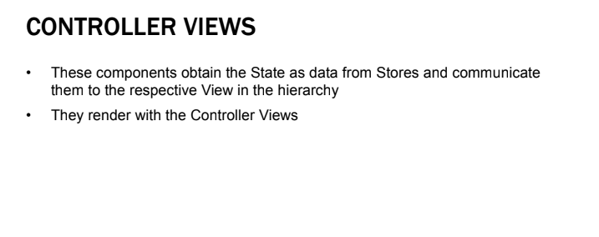
Here we are going to maintain data state, and depending upon that we are going to push that data to the stores,

Slide 95
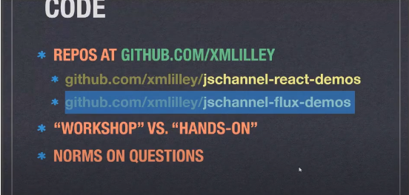
Small programs for flux
https://github.com/xml/jschannel-flux-demos

Slide 96
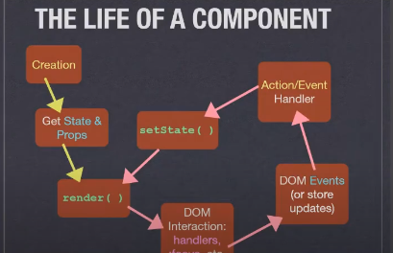

Slide 97
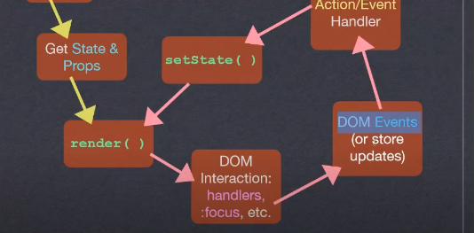

Slide 98
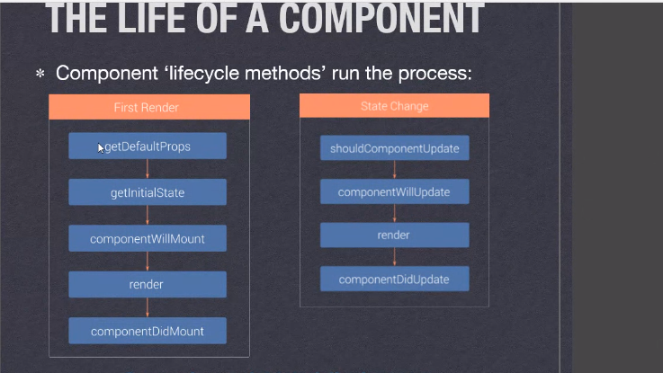

Slide 99
https://scotch.io/tutorials/getting-to-know-flux-the-react-js-architecture
Flux details
https://scotch.io/tutorials/getting-to-know-flux-the-react-js-architecture

Slide 101
React Redux
https://www.javatpoint.com/react-redux
React Redux
Redux is an open-source JavaScript library used to manage application state. React uses Redux for building the user interface. It was first introduced by Dan Abramov and Andrew Clark in 2015.
React Redux is the official React binding for Redux. It allows React components to read data from a Redux Store, and dispatch Actions to the Store to update data. Redux helps apps to scale by providing a sensible way to manage state through a unidirectional data flow model. React Redux is conceptually simple. It subscribes to the Redux store, checks to see if the data which your component wants have changed, and re-renders your component.
Redux was inspired by Flux. Redux studied the Flux architecture and omitted unnecessary complexity.
Redux does not have Dispatcher concept.
Redux has an only Store whereas Flux has many Stores.
The Action objects will be received and handled directly by Store.

Slide 102
Why use React Redux?
The main reason to use React Redux are:
React Redux is the official UI bindings for react Application. It is kept up-to-date with any API changes to ensure that your React components behave as expected.
Using React Redux one can design good 'React' architecture.
It implements many performance optimizations internally, which allows to components re-render only when it actually needs.

Slide 103
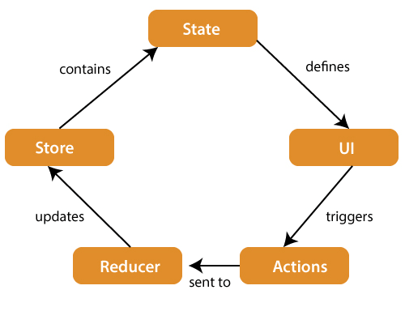
Redux Architecture

Slide 104
The components of Redux architecture are explained below.
STORE: A Store is a place where the entire state of your application lists. It manages the status of the application and has a dispatch(action) function. It is like a brain responsible for all moving parts in Redux.
ACTION: Action is sent or dispatched from the view which are payloads that can be read by Reducers. It is a pure object created to store the information of the user's event. It includes information such as type of action, time of occurrence, location of occurrence, its coordinates, and which state it aims to change.
REDUCER: Reducer read the payloads from the actions and then updates the store via the state accordingly. It is a pure function to return a new state from the initial state.
Redux Installation
Requirements: React Redux requires React 16.8.3 or later version.
To use React Redux with React application, you need to install the below command.
$ npm install redux react-redux --save
For redux example :- https://www.javatpoint.com/react-redux-example

Slide 105
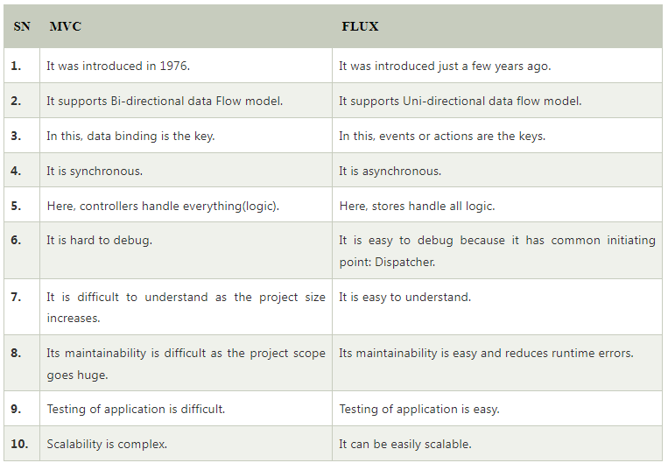

Slide 106
Advanced React
Flow architecture
MVC
Flux
https://www.clariontech.com/blog/mvc-vs-flux-vs-redux-the-real-differences
https://react-redux.js.org/introduction/quick-start
https://www.freecodecamp.org/news/an-introduction-to-the-flux-architectural-pattern-674ea74775c9/
https://facebook.github.io/flux/docs/in-depth-overview/
https://www.javatpoint.com/react-flux-vs-mvc

Slide 108
Bundling application Webpack
https://webpack.js.org/
https://www.freecodecamp.org/news/learn-webpack-for-react-a36d4cac5060/

Slide 109
Bundling the Application
For some application software installation, we require to install other dependent application software before.
Bundled Application means group of software such as application software and library file with the Application software to be install.
The bundle is distributed as complete download or installation with an application to be install. In the case of bundled application, the user will not separately download and install the Applications.
Bundling is the process of following imported files and merging them into a single file : a “bundle”.

Slide 110
Webpack
Webpack is a popular module bundling system built on top of Node. js. It can handle not only combination and minification of JavaScript and CSS files, but also other assets such as image files (spriting) through the use of plugins.
It is a code bundler that takes modules with dependencies and bundles them into web-readable static assets (HTML, CSS, JS).Webpack is a free and open-source module bundler for JavaScript. It is made primarily for JavaScript, but it can transform front-end assets such as HTML, CSS, and images if the corresponding loaders are included. Webpack takes modules with dependencies and generates static assets representing those modules.
It's a tool that lets you bundle your JavaScript applications (supporting both ESM and CommonJS), and it can be extended to support many different assets such as images, fonts and stylesheets.
Webpack is a module bundler. It takes disparate dependencies, creates modules for them and bundles the entire network up into manageable output files. This is especially useful for Single Page Applications (SPAs), which is the defacto standard for Web Applications today.
Webpack and Babel are tools for developers that optimize JavaScript applications. Webpack is a module bundler we can use to minify multiple files in a JavaScript project and increase the overall efficiency. A module bundler takes in all the assets and comes up with a single output file.

Slide 111
https://www.tutorialspoint.com/reactjs/reactjs_environment_setup.htm
https://www.tutorialspoint.com/webpack_for_beginners/index.asp#
https://www.freecodecamp.org/news/learn-webpack-for-react-a36d4cac5060/
https://tutorialzine.com/2017/04/learn-webpack-in-15-minutes
Code Github link:-
https://github.com/esausilva/react-starter-boilerplate-hmr

Slide 115
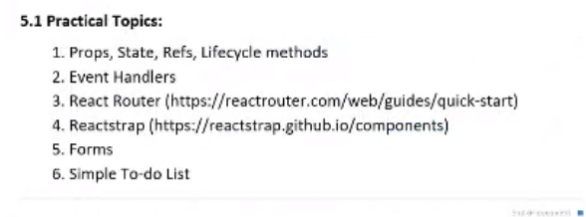
Now, we will see some of the practical topics
Creating simple project using existed library like React Router and Reactstrap,
Reactstrap makes use of class components whereas React-bootstrap makes use of functions and hooks. Both the codes yield similar output and the only difference is the use of the components. The user may choose either depending on their preferences.

Slide 116
The way we represented entire code is part of hooks, or life cycle in hooks. Now we will see how to declare ref’s functional component of react.

Slide 117
We will create another folder in src as refsDemo, inside this we will create another component call file as CounterUsingRef.js

Slide 118
CounterUsingRef.js
import React, { useRef, useState } from "react";
import "./CounterUsingRef.css";
function CounterUsingRef() {
const counterRef = useRef(0);
const [, forceRenderer] = useState(false)
let incrementCounter = () => {
counterRef.current = counterRef.current + 1;
forceRenderer((x) => !x)
console.log(counterRef);
};
let decrementCounter = () => {
counterRef.current = counterRef.current - 1;
forceRenderer((x) => !x)
console.log(counterRef);
};
return (
<div className={"counter-container"}>
<button className={"action-buttons"} onClick={incrementCounter}>
Increment (+)
</button>
{counterRef.current}
<button className={"action-buttons"} onClick={decrementCounter}>
Decrement (-)
</button>
</div>
);
}
export default CounterUsingRef;

Slide 119
index.js
import React from "react";
import ReactDOM from "react-dom";
// import App from './App';
//import ParentComponent from "./propsDemo/ParentComponent";
//import Counter from "./stateDemo/Counter";
import CounterUsingRef from "./refsDemo/CounterUsingRef.js";
import reportWebVitals from "./reportWebVitals";
ReactDOM.render(
<React.StrictMode>
<CounterUsingRef />
</React.StrictMode>,
document.getElementById("root")
);
// If you want to start measuring performance in your app, pass a function
// to log results (for example: reportWebVitals(console.log))
// or send to an analytics endpoint. Learn more: https://bit.ly/CRA-vitals
reportWebVitals();

Slide 120
CounterUsingRef.css
.counter-container {
display: flex;
justify-content: center;
align-items: center;
width: 100%;
height: 60vh;
}
/* button {
margin: 10px;
} */
.action-buttons {
margin: 10px;
}

Slide 121
In import React, { useRef, useState } from "react";
useRef, useState indicates?
They let you use state and other React features without writing a class. ... useReducer; useCallback; useMemo; useRef; useImperativeHandle; useLayoutEffect. Both preserve their data during render cycles and UI updates, but only the useState Hook with its updater function causes re-renders. useRef returns an object with a current property holding the actual value.
What is useState and useRef?
useRef returns an object with a current property holding the actual value. In contrast, useState returns an array with two elements: the first item constitutes the state, and the second item represents the state updater function.
What is the useRef hook used for?
The useRef Hook allows you to persist values between renders. It can be used to store a mutable value that does not cause a re-render when updated. It can be used to access a DOM element directly.

Slide 122
Difference between using Refs and using states
When we were using states or When component was getting re-rendered and we were saying latest value whenever any state was changes but whenever we try to change any ref the components doesn’t gets re-rendered.
Whenever you change any state variable like Counter is assigned a new location in the memory, For ex:- this variable Counter is stored at location called as a, and when you change the states by calling any of the increment or decrement function, the index or memory location of this variable got change to b. That’s the reason it causing the re-rendering of the component.
But the same thing is not with Refs (Ex:- counterRef), so when you try to update the ref, the same location is assigned to that specific variable. The location doesn’t gets changed. And that’s the reason states doesn’t gets updated.

Slide 123
When can we use refs?
If you want to keep track of something, and you want always latest updated thing at each and every place. Because if you use state and if you are passing this states to some other child component’s it’s possible that it may take some time to reach to that child component. So in order to avoid that what we can do, we can use this refs so that each and every component has the latest value available whenever required.
There is one drawback, we won’t able to rendered the component, if we use refs. Also whatever value is present inside this memory location, can be accessed using .current property (name of the variable.current).

Slide 124
So whatever value is present inside this memory location, can be accessed using .current property.
For ex:- counterRef.current

Slide 125
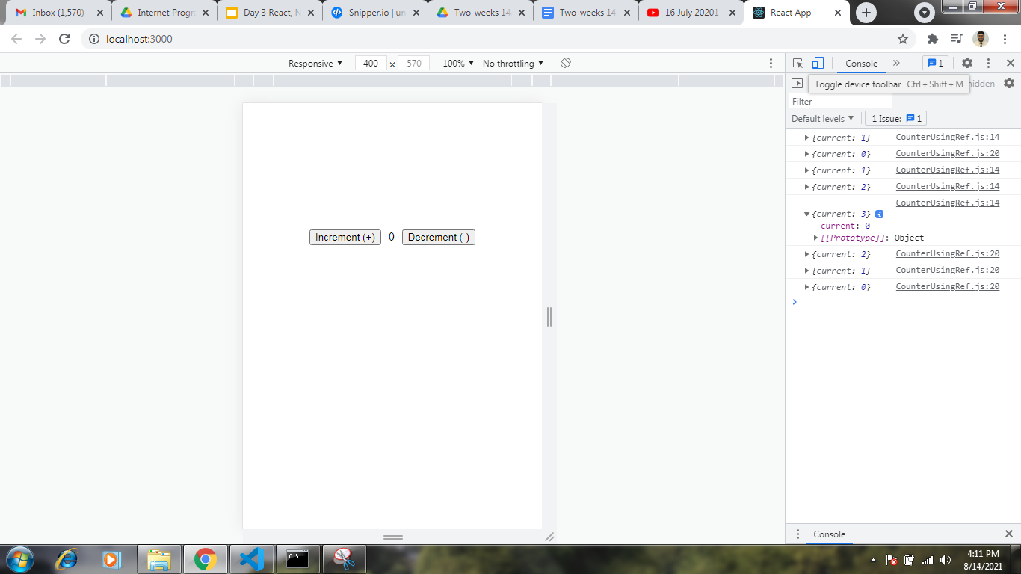
To check app on different viewport and devices press on toggle device toolbar

Slide 126
https://snipper.io/s/-McIYXR6cEvW-VVXUeKE
So for re-rendering purpose we have to create dummy state and update it whenever variable getting change.

Slide 127
How to create refs using functional component
To create a ref in a functional component we use the useRef() hook which returns a mutable object with a . current property set to the initialValue we passed to the hook.
This returned object will persist for the full lifetime of the component. Thus, throughout all of its re-rendering and until it unmounts.

Slide 128
https://snipper.io/s/-McIYXR6cEvW-VVXUeKE
Life cycle method available in react:-
Since we are working on functional component we have seen only one method as of now i.e. useEffect. For class component there were multiple different life cycle methods like componentWillMount(), componentDidMount() etc. Since we are working on functional component here all this life cycle methods are covered inside one life cycle method called useEffect.
What is useEffect in React?
What does useEffect do? By using this Hook, you tell React that your component needs to do something after render. React will remember the function you passed (we'll refer to it as our “effect”), and call it later after performing the DOM updates

Slide 129
UseEffectDemo.js
import React, { useState, useEffect } from "react";
function UseEffectDemo() {
const [toogleState, setToogleState] = useState(false);
const [newToogleState, setNewToogleState] = useState(false);
useEffect(() => {
// Use effect called every time when toogleState or newToggleState gets called
console.log("UseEffect called.");
}, [toogleState, newToogleState]);
// useEffect(() => {
// // Use effect called only once when component is mounted on DOM
// console.log("UseEffect called.");
// }, []);// if we are not providing any value inside [] then this render method called only once
// useEffect(() => {
// // Use effect called every time whenever any of the state changes in the component
// console.log("UseEffect called.");
// });
return (
<div>
<button onClick={() => setToogleState((x) => !x)}>Toogle Button</button>
<button onClick={() => setNewToogleState((x) => !x)}>
New Toogle Button
</button>
</div>
);
}
export default UseEffectDemo;

Slide 130
index.js
import React from "react";
import ReactDOM from "react-dom";
// import App from './App';
// import ParentComponent from "./propsDemo/ParentComponent";
// import Counter from "./stateDemo/Counter";
// import CounterUsingRef from "./refsDemo/CounterUsingRef";
import UseEffectDemo from "./useEffectDemo/UseEffectDemo";
//import FetchData from "./useEffectDemo/FetchData";
import reportWebVitals from "./reportWebVitals";
ReactDOM.render(
<React.StrictMode>
<UseEffectDemo />
</React.StrictMode>,
document.getElementById("root")
);
// If you want to start measuring performance in your app, pass a function
// to log results (for example: reportWebVitals(console.log))
// or send to an analytics endpoint. Learn more: https://bit.ly/CRA-vitals
reportWebVitals();

Slide 131
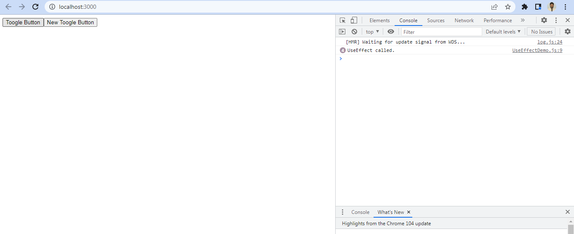

Slide 132
FetchData.js
import React, { useEffect, useState } from "react";
function FetchData() {
const endpointUrl = "https://jsonplaceholder.typicode.com/photos";
const [photos, setPhotos] = useState([]);
useEffect(() => {
fetch(endpointUrl)
.then((response) => response.json())
.then((photosData) => {
setPhotos(photosData);
})
.catch((error) => console.log(error));
}, []);
return (
<div>
{photos.length ? (
photos.map((photo, index) => (
<div key={index}>
<img src={photo.thumbnailUrl} alt={"Preview"} />
<p>{photo.title}</p>
<p>{photo.url}</p>
</div>
))
) : (
<p>No data available</p>
)}
</div>
);
}
export default FetchData;

Slide 133
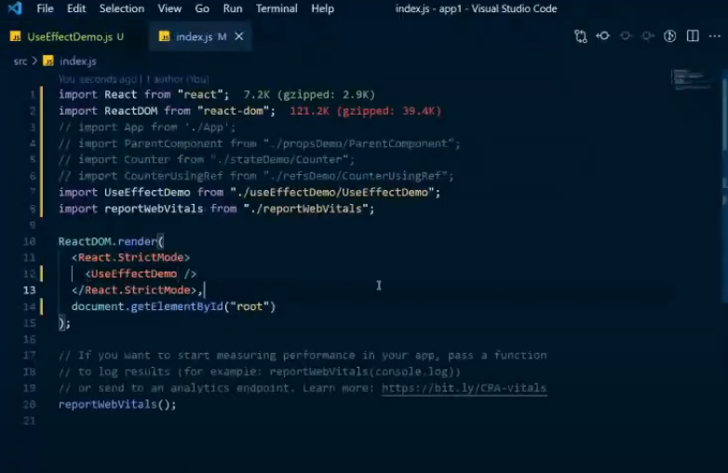

Slide 134
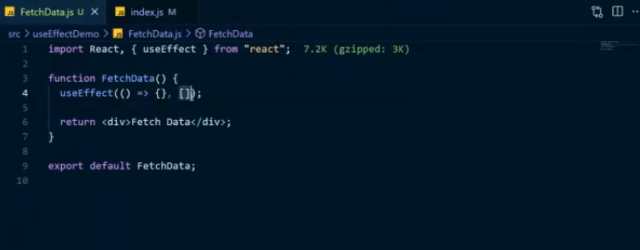
When should we use useEffect and what it does?
We will retrieve some data and print it on to console. So we will know how useEffect used.
Syntax of useEffect. useEffect is similar to arrow function. Inside this { } block we will have our own code and [ ] this is array which is called as dependencies array and whatever value you specify over here, will be use to trigger this useEffect(() function again and again.

Slide 135
Here we have one state similar to what we developed in counter.js, whenever a state gets changed and if there is a value of the state specified over here then, this useEffect(() function triggered again and again.

Slide 136
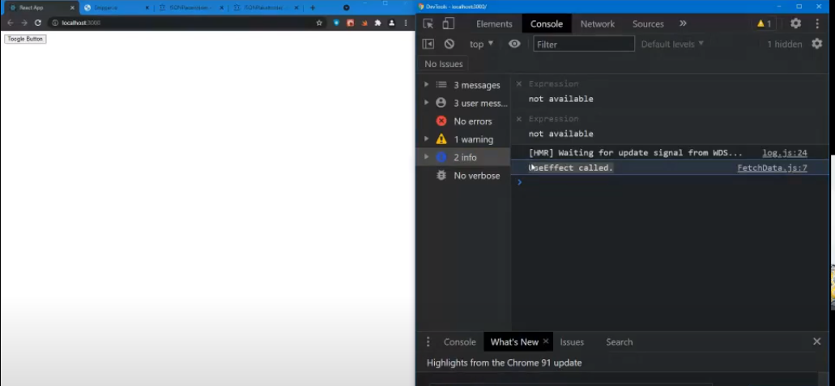
Toggle button
If you try to reload the page then it will show UseEffect called. In Console. This is called once no matter how many state changes takes place. If you try to click overtoggle button nothing will change, useEffect not getting called. useEffect gets called only once when your component got mounted.

Slide 137


Slide 138

Once you clicked on toggle button console will do the changes , useEffect gets triggered again.

Slide 139

useEffect will be called when state gets changes. When you clicked on toggle button.

Slide 140
Practically where it is used?
Whenever you want to fetch any data from the server, when your apps gets load for the first time and display data on the your website that is where useEffect is use. That’s where we specified the dependencies array and how many times this function will called depending upon the state change.
Example :- Fetch data from dummy API like
https://jsonplaceholder.typicode.com/
https://jsonplaceholder.typicode.com/photos

Slide 141

Here we will try to fetch any of the data and we will see how useEffect come into the picture.

Slide 142

This is where useEffect is used.

Slide 143

Basically Creating, retrieving, updating and deleting the record such a operations are performed on data i.e CURD operations for REST API.
Here couple of routes are available for API’s.
First we will see how can we perform get?
This indicates that if we hit this route or this endpoint /posts then we should get all the data w.r.to post over here.

Slide 144
https://jsonplaceholder.typicode.com/photos
First thing we will do is try to fetch result and display it on console.

Slide 145

https://www.flipkart.com/

Slide 146

Inside preview we can see the background color as ##, this is where useEffect come into the picture.

Slide 147
Whenever your component gets mounted then use useEffects, to do the further computation.
For more details :
https://reactjs.org/docs/hooks-intro.html

Slide 148
Simple Single page applications- (To-do List)

Slide 149
Java and Javascript are two different aspects, Java came into picture in 1995 and javascript in 1996. Java, C++,C#, Ruby are all based on object oriented programming and mother of all this language is C. C is a procedural based language.
Who is mother of Javascript ?
Before javascript we were having Livescript, Brendan Eich created JavaScript in 1996. He was a master of two languages scheme and self language, here scheme is functional based programming and self is prototype based programming.

Slide 150
Mosaic was the first browser came into world, which was a static web browser. Static means there is no continuous data, we can not change data, it’s totally static web browser. We have netscape company having Netscape Navigator so they decided to make dynamic web browser, so here Brendan Eich who created and used Livescript language for the Netscape Navigator to make it dynamic.
At the same time OOP came into market so he took syntax of java not the concept of java, and added functional based and prototype based programming to make script called as Livescript. Because of syntax of java he has converted the name of LIvescript to Javascript.
Now there was one company called as Microsoft, that has browser called as MS IE (Internet Explorer). Now this IE having VBScript as programming language.

Slide 151
When we compare VBScript and JavaScript, VBSCript is Kid and Javascript is Dad in the market. Now to make a compatible with javascript Microsoft came up with programming language called as JScript. JScript is a clone of Javascript, that’s the reason Microsoft is called in the market as Anu Malik, because he made a clone of javascript. But obviously as it is a clone it is not going to be successful.
So at the end we have only one and only competitor for javascript is javascript itself. Now in 1995 and 1996 was era where people were having computers oe systems which were having less hardware at the client side, and this javascript was written for client side scripting and in this era the hardware was not at particular level where we can push load from server to client, where as this java, PHP is basically for server based and we had lot of stuff at server side. Now in 2007 there was a drastic change in hardware, i5, i7,core to duel so on and so forth. This was a power of hardware at client side, now we can adjust/push server side load at client side so that at the client side we can able to handle many of the things, at that time server will be free for another stuff, and this is how framework came into picture and in 2007 one major aspect came that is called ECMA ekmaa (European Computer Manufacturer's Association) which was a standard came into market, and in 1st jan 2020 ES6 came into the market, which we have studied in 2nd chapter.

Slide 152


Slide 153
After that Netscape Navigator change it’s name to mozilla browser, all this stuff written in javascript that’s the reason it is called MDN (the Mozilla Developer Network) Javascript, which having whole tutorial of javascript,
ES2020 came up with ECMA standard, so Mozilla , Microsoft IE registered in ECMA, so ultimatilly all the browser register themself to ECMA.
Example:- If you are manufacturing a car then we have register with registry organisation to follow the standards, for car BS is std. And for browser ECMA is std.
Now whatever std. Comes into ECMA is 1st come into chromium, then chrome canary browser then after successfully tested in above two it will come into chrome which we are using, this is what now actually happening in the world not in 1997,

Slide 154
For compiler and interpreter we required browser, There are different engines, we have V8 fastest engine in chrome, Firefox FF having spider Monkey, for IE explorer we have chakra available etc..
https://en.wikipedia.org/wiki/Brendan_Eich
CEO of Brave Software.
Brave browser is purely written in javascript, so whatever ECMA std. Is going to come up in the market today and tomorrow it is going to picked up by this particular browser immediately, that means whatever we are developing the programs flux, react.. etc. all this stuff if we want to run it very nicely then the recommandation goes for the Brave Browser, Google chrome,

Slide 155


Slide 156


Slide 157
Now here we are talking about functional based programming, where function is going to create object, function is calling function, here we have to think functional based programming not the object oriented programming where a class is going to create object and here function is going to create object. This is difference between OOP and Javascript.

Slide 158

Functional Based Programming
Promise:- Visit to dominos
IF we are able to write a program like this, then we will be able to implement basic features of ES6.

Slide 159
In a new window of browser simply write
about:blank

Slide 160


Slide 161

Here one function calling another function setTimeout calling function

Slide 162
function iamAsync(success,fail){
var a = 10;
setTimeout(function(){
console.log("I am After 5 Sec Going to Return ");
if(a>10){
success("I am the Result of Async"); // I am Calling the CallBack
}
else{
fail("Some Error Occur ");
}
//return "I am The Result of Async ";
//document.write('I will call after 5 sec ');
},5000);
}

Slide 163
function giveMeResult(result){
console.log(" I am the Result ",result);
}
-----------------------------------
function fail(err){
console.log(" I am Fail Error ",err);
}
-------------------
iamAsync(giveMeResult,fail);

Slide 164

function giveMeResult(result){
Here result parameter Is going to retrieve the answer (sucess or fail message)

Slide 165
Just change the value in if as (a>5) rest all keep it as it is
function iamAsync(success,fail){
var a = 10;
setTimeout(function(){
console.log("I am After 5 Sec Going to Return ");
if(a>5){
success("I am the Result of Async"); // I am Calling the CallBack
}
else{
fail("Some Error Occur ");
}
//return "I am The Result of Async ";
//document.write('I will call after 5 sec ');
},5000);
}

Slide 166


Slide 167
It’s a Steps to moving towards Flux i.e UI
https://github.com/yogeshpingle/Tic_Tac_Toe
Tic_Tac_Toe:- Game
Install live server it helps us to execute we don’t required Xampp, Wamp servers etc. here we have middleware server with the help of which we can run our code.

Slide 168

If it is not opening in browser then install Live server Extension
Library which we are using for bootstraping

Slide 169
Use of bootstrap
Bootstrap is a potent front-end framework used to create modern websites and web apps. It's open-source and free to use, yet features numerous HTML and CSS templates for UI interface elements such as buttons and forms. Bootstrap also supports JavaScript extensions.
Bootstrap is a responsive web.
<script src="logic.js"></script>
I am retrieving this external script file, it is a separate file created so that we can use here in this code.

Slide 170
In style.css
Here .(dot) represent classes which we have already written in index.html, for ex:-
.Header, .Play_Arena , .Play_Arena_Box_Class etc.
While designing project 1st thing we must know is layout how my output window will look a like and what exactly I want to be displayed i.e. HTML File and CSS file,

Slide 171
logic.js
Here whole logic is functional based,
function Box_Click(Box_Id_Num)
{
Here I am passing the id from
<button class="Play_Arena_Box_Class" id="Play_Arena_Box_1" onclick="Box_Click(id)"
What ever id I am passing it is going to be inif(document.getElementById(Box_Id_Num)
In logic.js. This DOM based function. Also it will going to display the symbols as O or X through innerHTML. Winnerfinder function is also preset.

Slide 172


Slide 173


Slide 174

http://127.0.0.1:5500/index.html
This are the buttons having area defined, this UI having 4 lines and 9 buttons and it should be responsive for that we are using Bootstrap.

Slide 175
Steps to execute Live server
https://marketplace.visualstudio.com/items?itemName=ritwickdey.LiveServer

